Slide 1


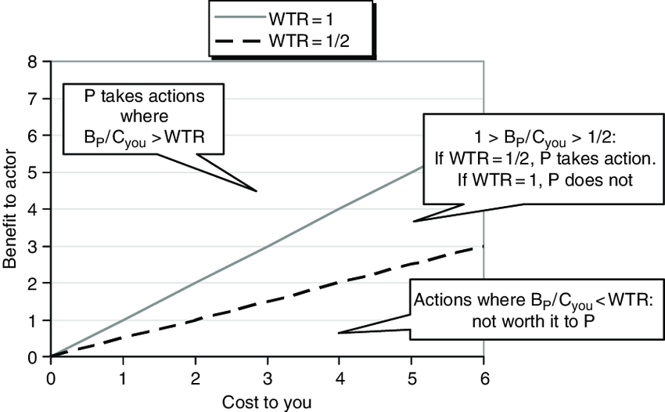
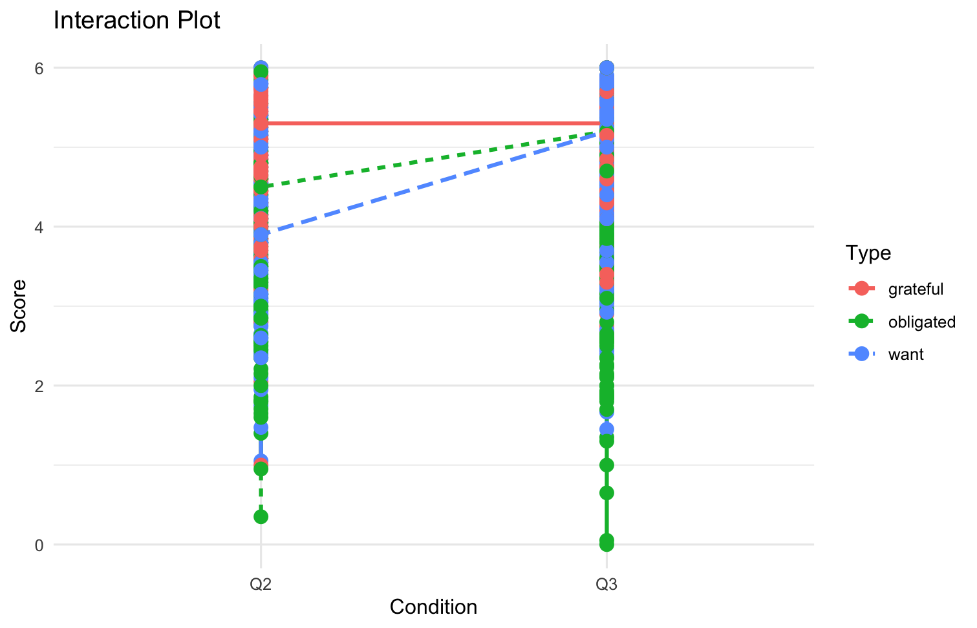
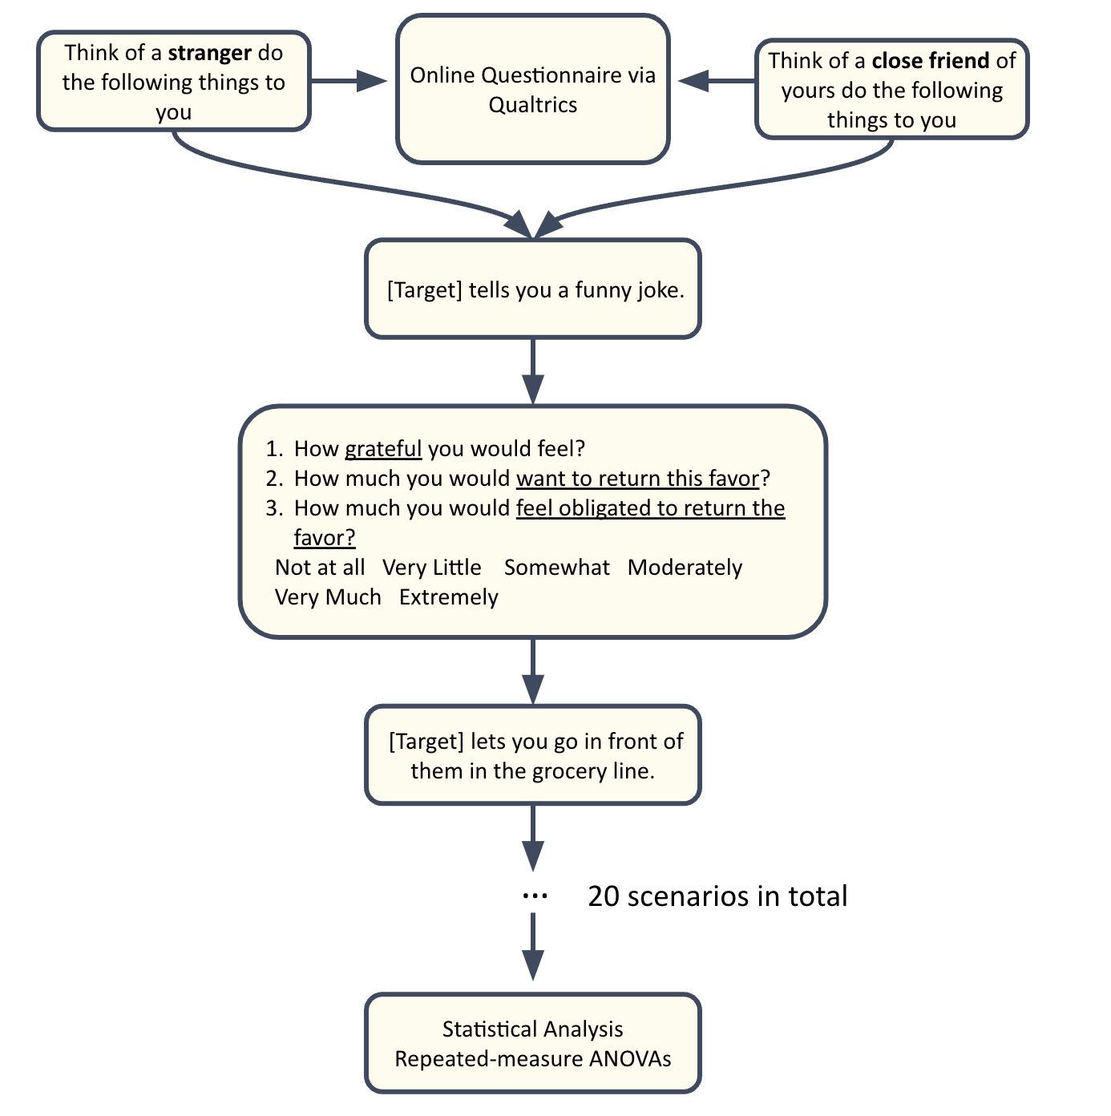
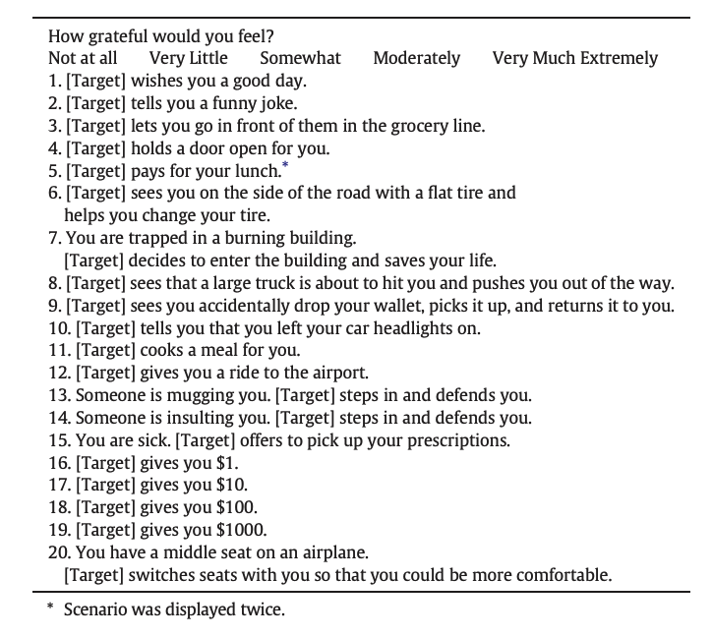
Benefit Valuation and Gratitude
Correspondence to: Qizhou Duan (qduan@nd.edu)
Qizhou Duan¹, Chenlingxi Xu¹, Isebel Huang², Lee Kirkpatrick¹
¹ University of Notre Dame, ² The College of William and Mary
INTRODUCTION
Gratitude & Welfare Tradeoff Ratio
RESULTS
Evolutionary psychology claims that emotion has its adaptive function
The welfare-tradeoff ratio (WTR) is a neurocomputational variable that many emotions incorporate in the decision-making process
WTR: The perceived willingness of one party to forgo resources to benefit another (Tooby and Cosmides (2008))
For example, anger arise in order to raise other’s WTR toward oneself
Gratitude typically evoked when one receives costly, unexpected, and intentionally rendered benefits, and is thought to play a key role in regulating the initiation and maintenance of social relationships
Forster et al. (2017, Front Hum Neurosci.) proposed that gratitude was elicited when there was an incongruence of perceived benefits versus expected benefits
gratitude would be inversely correlated with a welfare-tradeoff ratio
However, previous studies found a null result
Why?
Altruism (Hamilton’s rule): ∑ rj* bj > cj (recipient j and actor i)
Different Emotions and their effects on WTR: Love and Affection (increase WTR); Anger (recalibrate WTR in favor of the angry individual); Guilt and Gratitude (Avoid making others angry and thus keeps up positive reciprocity)
WTR:
ANOVA:
Significant main effect of Person-Type(p<0.001), Question-Type(p=0.06) and Question x Person Interaction (p=0.038)
Significant difference between different framing of the questions, and also difference between close friend vs. stranger
Under both friend & stranger condition
significant difference between gratefulness & obligation to return the favor
Correlation:
When asked to think about a friend in the situation, the perceived benefit is significantly correlating with obligation, gratefulness and want to return the benefit (r=0.455, 0.451 and 0.466 respectively)
RESEARCH QUESTION
CONTENT VALIDITY
RQ: The goal of our study is to attempt to improve the questionnaire used in Forster et al. 2017 paper, and ultimately check once the measurement tool is improved, whether the result would still remain counterintuitive.
Hypothesis:
We expect to find an interaction, such that gratefulness does not differ between targets (as found by Forster et al. 2017) but that both desire to reciprocate and obligation to reciprocate) do differ between targets; specifically, the desire and obligation to reciprocate a stranger’s favor is greater than for a friend’s favor.
The extent to which we are measuring what we intend to measure.
Is established through a rational analysis of the content of a test, and its determination is based on individual, subjective judgment.
Face Validity vs Logical Validity
A person examines the test and conclude it measures relevant trait, and if people disagree, face validity is in question.
Logical Validity is a more sophisticated version of face validity. It involves: (1) careful definition of the domain of behaviors and, (2) logical design of items to cover all the important areas of this domain.
DISCUSSION & Future Directions
Further refine the items in the survey
Create an Item Bank for the survey
Conduct Item analysis
Conduct reliability and validity study
Ultimately develop a new scale for measuring welfare tradeoff ratio
Counterbalance the sequential in which the questions were given
Obtain WTR ratio measures from the participants.
Scale anchoring, social desirability, carryover effect (Response Biases)
Procedure
table 1: questions in the survey
194 college students participated (54% female, mean age: 20.4)
Stimuli for scenarios in the Experiment
As you think about how you would feel in response to the situation below, please keep the following assumptions in mind:
- Each scenario happened in isolation from all other scenarios.
- [Target] is in good health and in a financially secure position.
REFERENCES
Forster, D. E., Pedersen, E. J., Smith, A., McCullough, M. E., & Lieberman, D. (2017). Benefit valuation predicts gratitude. Evolution and Human Behavior, 38(1), 18-26.
Zhang, J. (2023). A neurocomputational variable on welfare tradeoffs explains the function and form of cyberaggression. Frontiers in Behavioral Neuroscience, 17, 1034564.
Hartig, B. (2011). A Welfare-Tradeoff-Ratio-Model of Social Preferences (No. 02-05). Cologne Graduate School in Management, Economics and Social Sciences.
Tooby, J., Cosmides, L., Sell, A., Lieberman, D., & Sznycer, D. (2008). Internal regulatory variables and the design of human motivation: A computational and evolutionary approach. Handbook of approach and avoidance motivation, 15, 251.
Algina, J., & Penfield, R. D. (2009). Classical test theory. The Sage handbook of quantitative methods in psychology, 93-122.
figure 1: description of the survey
Notes:
mpa slides: https://docs.google.com/presentation/d/17ASeSuCMX3GV8TyI8klEYpMpbS5JYYkn96dfPdZavco/edit#slide=id.g1eab84e68fc_0_26
1

